Slide 1
Introduction

Slide 2
Purpose of meeting:
In search of internship, based on my skills.
And business growth of Filli Cafe,.

Slide 3
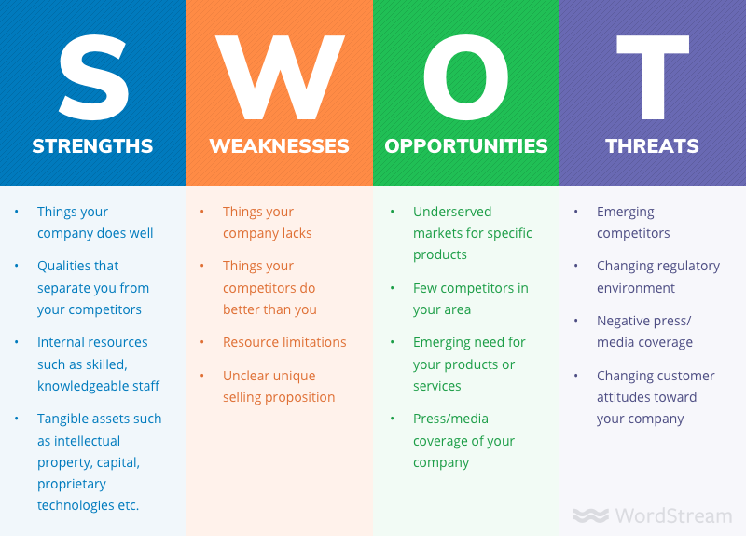
Research:
According to Restaurant time:

Slide 4
How can we focus more on SWOT?
Big Data is Changing The Business World according to forbes :
1. Improved Business Intelligence
Analyzing businesses has become easier and more effective thanks to business intelligence. The set of data tools that makes business intelligence possible is big data.
2. Understanding, Targeting And Serving Customers.
3. The Introduction Of Customer Responsive Products.
Rather than relying on customers to tell a business what they want from a product, data analysis can be used to predict what is wanted out of a product.

Slide 5
Filli Cafe has database :
If :
Yes
Can I be intern to answer the questions like,( Based on Filli’s Menu) :
Q1) What type of sandwiches customer’s like most?
Q2) Maximum revenue generated through Franchise or Cafe?
Q3) Which Iceage are preferred most ? Iceage season wise?

Slide 6
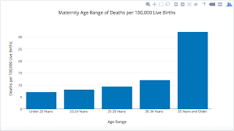
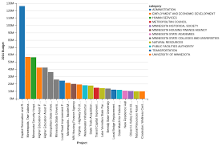
Visualisations :
Violin plot, Line Graph ,etc

Slide 7
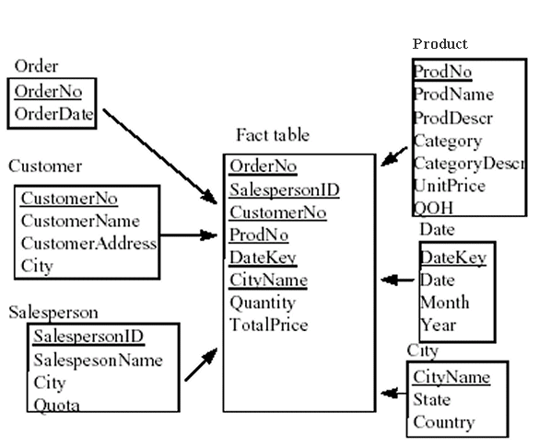
If (No) :
Help you to design Database :
Model like this will help the concern person very well : Eg- Fact table

Slide 8
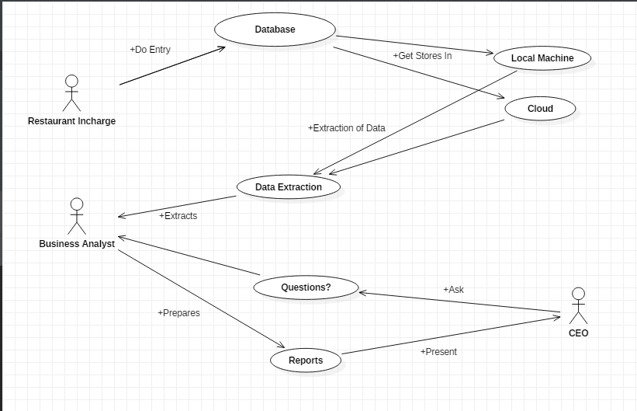

Slide 9
Reference :
https://www.forbes.com/sites/forbestechcouncil/2018/07/31/eight-ways-big-data-and-ai-are-changing-the-business-world/#34f20d445b6d
https://smallbusiness.chron.com/swot-analysis-coffee-cafe-15644.html

